Slide 1

Four-Element UWB MIMO Antenna System With a Square Frame Decoupling Structure for Enhanced Isolation and Polarization Diversity Characteristics
by
Batch no: C5
T.LAKSHMI DURGA 23NG5A0427
D.KISHORE 22NG1A04F1
SK.NAGUR SAIDA 23NG5A0423
K.SYAM PRASAD 22NG1A04G0
Under the Esteemed Guidance of
Dr. A. Suneel Kumar M.Tech, Ph.D
Associate professor
Department of Electronics and Communication Engineering

Slide 2
CONTENTS
Abstract
Existing system
Proposed system Block Diagram
Expected outcomes
Requirements: Software / & Hardware
Advantages
Applications
References

Slide 3
1.ABSTRACT
A cost-effective antenna is proposed for Ultrawideband (UWB) applications, focusing on compactness and performance.
Achieves a wide operating range from 3.7 GHz to 15.7 GHz (12 GHz bandwidth)
A four-element MIMO setup is arranged orthogonally to enhance diversity and spatial performance.
MIMO mode, bandwidth improves to 2.9 GHz to 16.2 GHz, covering more UWB spectrum.
Delivers a maximum gain of 5.5 dBi at 14 GHz with >80% total efficiency across the resonance band
Compact design — 20×26 mm² for a single element and 46×48 mm² for the full MIMO array.

Slide 4
2.EXISTING SYSTEM
Single element UWB antennas like monopole and slot designs supported wide bandwidth but lacked MIMO diversity.
Multi-element MIMO antennas suffered from strong mutual coupling when elements were placed close together.
Many designs used a common ground plane without modification, which reduced isolation.
The operating bandwidth was often limited to around 3–10 GHz, not covering higher frequencies.
Antenna size was relatively large, making it unsuitable for compact devices.
Some systems used multilayer substrates or expensive materials, making them less cost-effective.
MIMO antennas are widely used to improve channel capacity, reliability, and spectral efficiency.

Slide 5
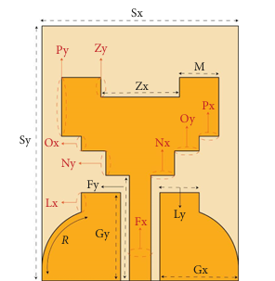
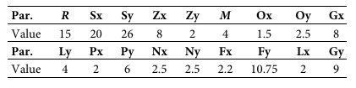
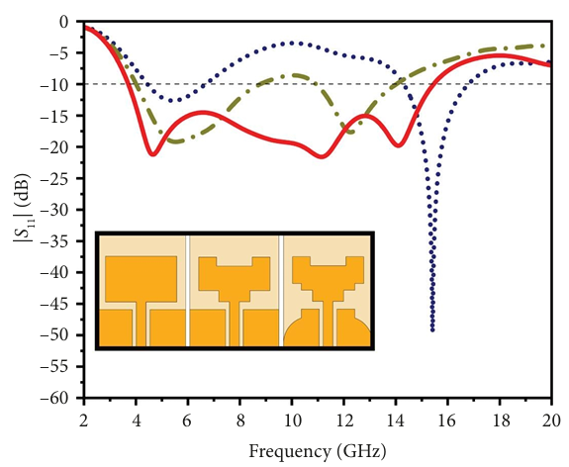
2.1 Single Element Antenna:
Table 1: Proposed antenna dimensions
Figure 1: Proposed CPW UWB antenna
Three curves are shown:
Stage 1 (dotted blue line) : initial design of the antenna.
Stage 2 (dashed green line) : improved design.
Stage 3 (solid red line) : final optimized antenna.
Figure 2: Design evolution of the UWB antenna.

Slide 6
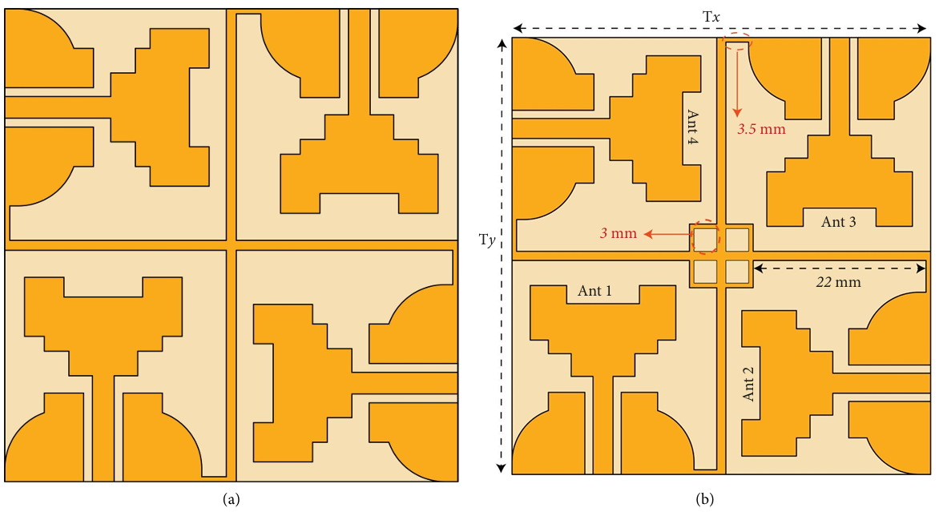
2.2 Four-Port MIMO Antenna :
Figure 3: UWB MIMO with connected ground plane: (a) Structure 1 and (b) Structure 2.

Slide 7
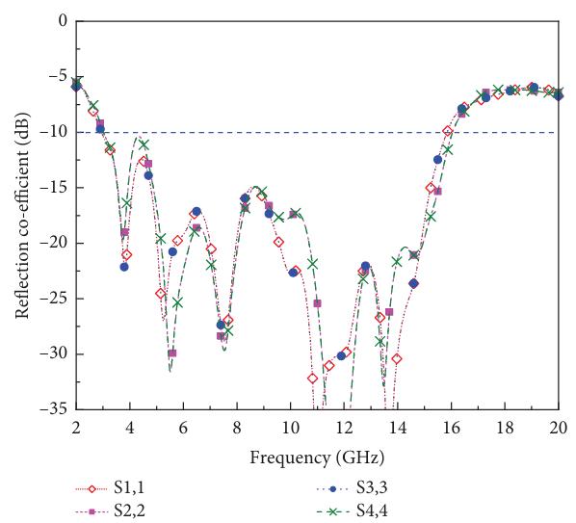
2.3 Existing System Result
Figure 4: simulated S-parameters reflection coefficients.
The diagram shows the return loss (reflection coefficient) of all 4 antenna elements in a UWB MIMO system.
All four ports (S1,1 / S2,2 / S3,3 / S4,4) have good matching and cover a wide range of frequencies

Slide 8
2.4 Existing System Drawbacks:
Moderate gain.
Low efficiency at higher frequencies.
Efficiency slightly drops at extreme frequencies.
Antenna footprint increases in MIMO configuration.
Parasitic element adds design complexity.

Slide 9
3.PROPOSED SYSTEM & IT’S WORKING
Start
Select Application and Select substrate
Create substrate and ground
Create patch and feedline
HFSS simulation
Verify design model and its parameters
Assign excitation and boundary
Fabrication process
Validate performance for UWB applications
VNA Testing
(S11,VSWR)
END

Slide 10
4.EXPECTED OUTCOMES
Maintaining total efficiency above 85% across the resonance bandwidth
Stable MIMO performance metrics (ECC, MEG, DG) within acceptable limits
Suitability of the proposed UWB–MIMO antenna for diverse UWB wireless applications.
Arrange elements more symmetrically for stable polarization.
Use simple matching methods to cover more frequency range.

Slide 11
5.REQUIREMENTS:
Software:
High-frequency structure simulator (HFSS)Software.
Hardware:
Antenna fabrication
Vector Network Analyzer (VNA) Hardware testing.

Slide 12
6.ADVANTAGES
Small size, easy to fit in devices
Four antennas improve signal quality and reliability
Special structure reduces interference between antennas
Provides good signal strength
Low cost because it uses FR4 material
Suitable for many wireless applications

Slide 13
7.APPLICATIONS
Wireless communication systems
High-speed data transfer
Mobile and portable devices
Wireless sensor networks
Radar and imaging systems
Internet of Things (IoT) devices
Medical monitoring and imaging

Slide 14
8.REFERENCES
1. A. A. Ibrahim and M. F. Abo Sree, “Uwb Mimo Antenna with 4-element, Compact Size, High Isolation and Single Band Rejection for High-Speed Wireless Networks,” Wireless Networks 28, no. 7(2022): 3143–3155, h
2. C. Suresh, T. S. Reddy, B. T. P. Madhav, et al., “A Novel Design of Spike-Shaped Miniaturized 4 × 4 MIMO Antenna for Wireless UWB Network Applications Using Characteristic Mode Analysis,” Micromachines 14, no. 3 (2023): 612, https:// do
3. A. C. Suresh, T. S. Reddy, B. T. P. Madhav, et al., “A Novel Design of Spike-Shaped Miniaturized 4 × 4 MIMO Antenna for Wireless UWB Network Applications Using Characteristic Mode Analysis,” Micromachines 14, no. 3 (2023): 612, https:// doi.org/10.3390/mi14030612.i.org/10.3390/mi14030612.ttps://doi.org/10.1007/ s11276-022-03019-4.
4. T. Addepalli, G. N. Kumar, C. J. Rani, et al., “A Defected Substrate 4-Element MIMO Antenna With Higher Diversity Characteristics for 5G Sub-6 GHz N77/N78 Band Applications,” Wireless Networks 31, no. 2 (2024): 1931–1947, https:// doi.org/10.1007/s11276-024-03864-5.
5. C.S. Anki reddy , T.S. Reddy, and B .Madhav, “Design and Verification of an Umbrella Shaped Narrow Band- Uwb Antenna Pair for Mimo Applications Using Characteristic Mode Analysis ,” E-Prime-Advances in Electrical Engineering, Electronics and Energy 8 (2024): 100545, https://doi.org/ 10.1016/j.prime.2024.100545.

Slide 15
QUERIES ?

Slide 16
THANK YOU

